Slide 1
Final Review
USC CSCI 544: Applied Natural Language Processing
Jonathan May -- 梅約納
Nanyun (Violet) Peng -- 彭楠赟
November 30, 2018

Slide 2
Topics in order of demand
IBM Models & EM algorithm
Word Embeddings
RNNs & LSTMs
Attention (and Neural MT)

Slide 3
EM For Word Alignment

Slide 4
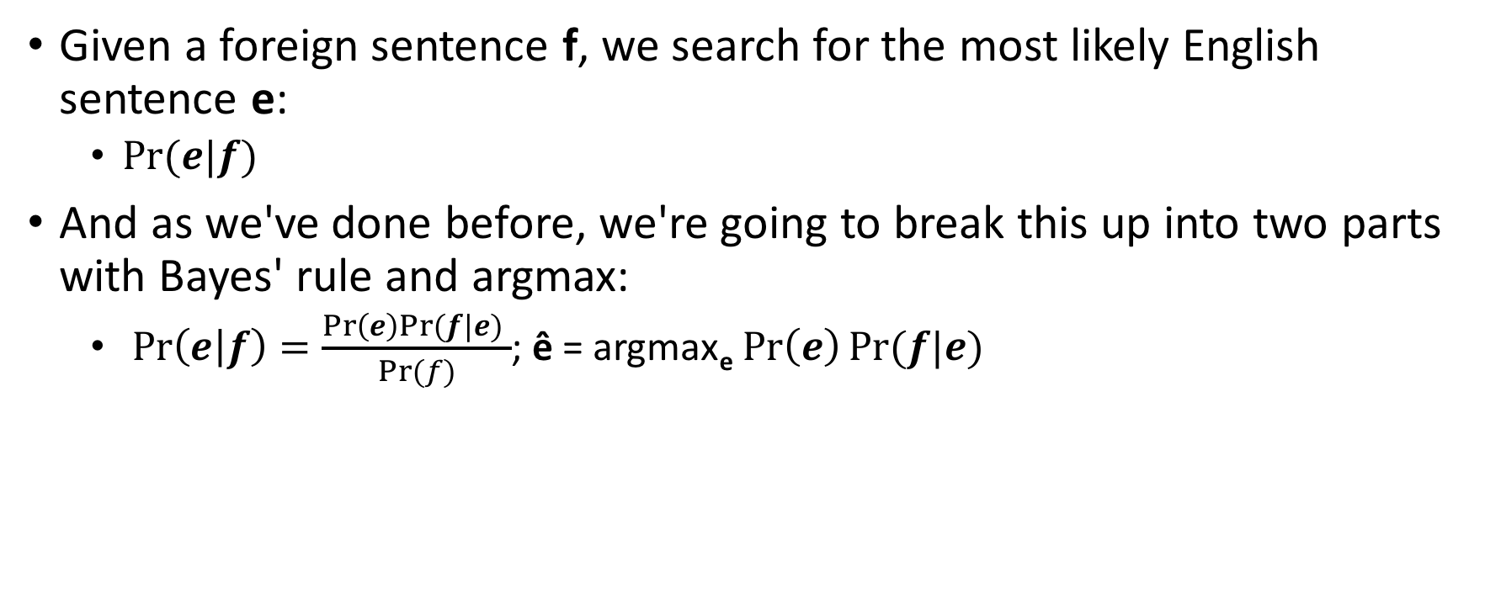
How To Generate A Translation
Given a foreign sentence f, we search for the most likely English sentence e:
$Pr⁡(e|f)$
And as we've done before, we're going to break this up into two parts with Bayes' rule and argmax:
$\operatorname{Pr}\left(e | f\right)=\frac{\operatorname{Pr}\left(e\right)Pr⁡(f|e) }{Pr⁡(f)}$; ê = argmax_{e} $\operatorname{Pr}\left(e\right)Pr⁡(f|e)$
translation model
language model
(previously covered)

Slide 5
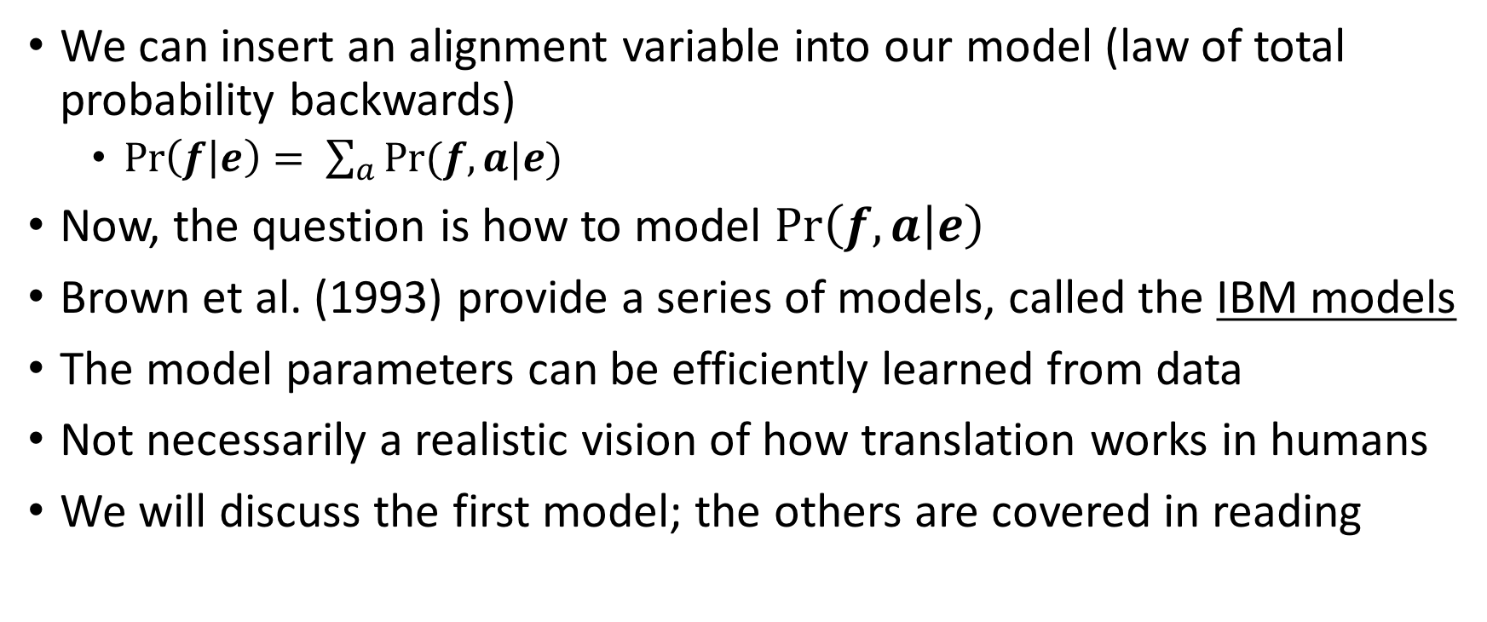
Modeling with Alignment
We can insert an alignment variable into our model (law of total probability backwards)
$\operatorname{Pr}\left(f | e\right)= \sum_{a}{Pr⁡(f, a|e)}$
Now, the question is how to model $\operatorname{Pr}\left(f, a | e\right)$
Brown et al. (1993) provide a series of models, called the IBM models
The model parameters can be efficiently learned from data
Not necessarily a realistic vision of how translation works in humans
We will discuss the first model; the others are covered in reading

Slide 6
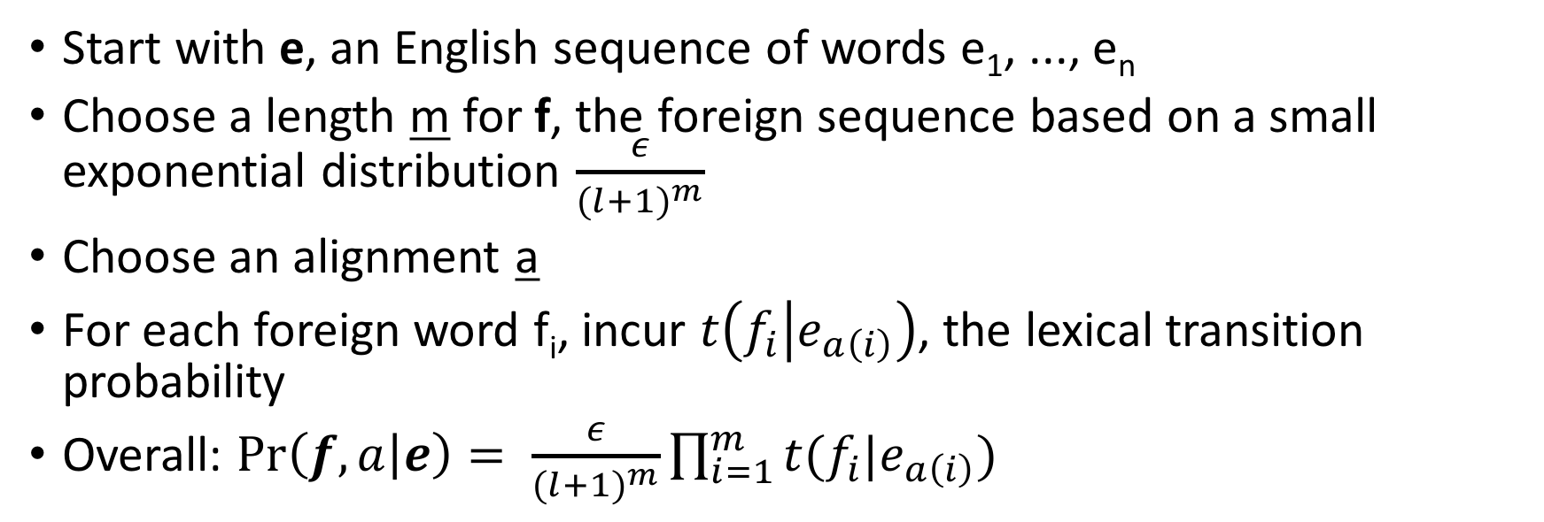
IBM Model 1 Generative Story for Pr(f, a|e)
Start with e, an English sequence of words e₁, ..., e_{n}
Choose a length m for f, the foreign sequence based on a small exponential distribution $\frac{ε}{{(l+1)}^{m}}$
Choose an alignment a
For each foreign word f_{i}, incur $t\left(f_{i} | e_{a\left(i\right)}\right)$, the lexical transition probability
Overall: $\operatorname{Pr}\left(f, a | e\right)= \frac{ε}{{(l+1)}^{m}}\prod_{i=1}^{m}{t(f_{i}|e_{a\left(i\right)})}$
the house is small
a: {1 -> 4, 2 -> 3, 3 -> 1, 4 -> 2}
klein
ist
das
Haus
____
____
____
____
ε/(5⁴)
* t(klein|small)
* t(ist|is)
* t(das|the)
* t(Haus|house)

Slide 7
Where do the transition probabilities come from?
This generative story is dependent on t(f|e), i.e. word-to-word probabilities. But we don't have them!
If we had a corpus of f, e pairs with alignments a, we could form t(f|e) via a maximum likelihood estimate. But we don't have alignments!
If we had t(f|e) we could use that to figure out the most likely alignment for a sentence pair. But see above...
la maison bleu
la, the = 12 13 | the = 45 46
maison, house = 7 8 | house = 14 15
bleu, blue = 6 7 | blue = 9 10
(made up numbers)
the blue house
la|the = 13/46 | la|blue = 0/10 | la | house = 2/46
maison| house = 8/15 | maison|the 0/46 | maison | blue = 0/10
la maison bleu
the blue house

Slide 8
IBM Model 1 and EM
EM Algorithm consists of two steps
Expectation (E) Step: Apply model to data
parts of the model are hidden (here: alignments)
using the model, assign probabilities to possible values
think of this as 'creating data'
Maximization (M) Step: Estimate model from data
which data? the data we just created!
take the assigned values as fact
collect counts weighted by probabilities
estimate model from counts
think of this as 'count and divide'
Iterate these steps until convergence

Slide 9
Assume we had a set of alignments
 | das | Buch
the | x
book |  | x
 | das | ein | Buch | Haus
the | 2/2
a |  | 1/1
book |  |  | 1/1
house |  |  |  | 2/2
 | das | Haus
the | x
house |  | x
 | ein | Haus
a | x
house |  | x
We could just collect counts and divide

Slide 10
We don't
 | das | Buch
the | ? | ?
book | ? | ?
 | das | Haus
the | ? | ?
house | ? | ?
 | ein | Haus
a | ? | ?
house | ? | ?

Slide 11
We don't
c | das | ein | Buch | Haus
the | .15+.5+... |  | .15+.05+...
a
book | .3+.05+... |  | .3+.5+...
house
 | das | Buch
the | x | x
book
 | das | Buch
the
book | x | x
 | das | Buch
the | x
book |  | x
 | das | Buch
the |  | x
book | x
* .15
* .3
* .5
* .05
 | das | Haus
the | x | x
house
(those weights are made up [for now])
...
 | ein | Haus
a | x | x
house
...
So we'll collect counts over every possible alignment
But we'll only trust the counts as much as we trust the alignment, i.e. Pr(a|e, f)

Slide 12
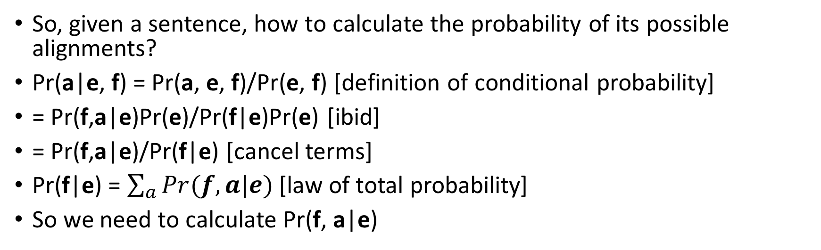
E-Step
 | das | Buch
the | x | x
book
 | das | Buch
the
book | x | x
 | das | Buch
the | x
book |  | x
 | das | Buch
the |  | x
book | x
?
?
?
?
So, given a sentence, how to calculate the probability of its possible alignments?
Pr(a|e, f) = Pr(a, e, f)/Pr(e, f) [definition of conditional probability]
= Pr(f,a|e)Pr(e)/Pr(f|e)Pr(e) [ibid]
= Pr(f,a|e)/Pr(f|e) [cancel terms]
Pr(f|e) = $\sum_{a}{Pr(f,a|e)}$ [law of total probability]
So we need to calculate Pr(f, a|e)

Slide 13
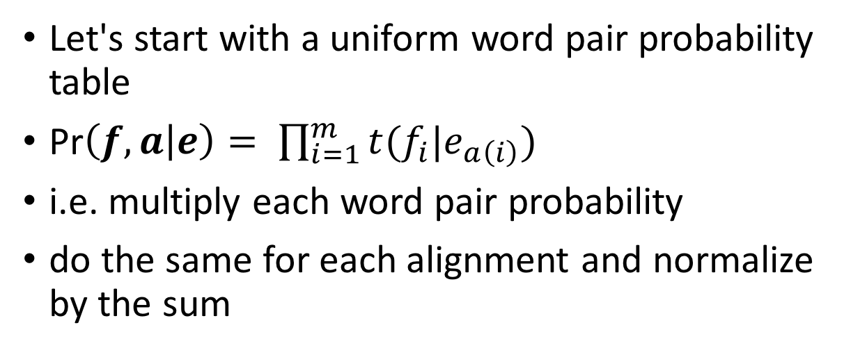
E-Step
 | das | Buch
the | x | x
book
 | das | Buch
the
book | x | x
 | das | Buch
the | x
book |  | x
 | das | Buch
the |  | x
book | x
?
?
?
?
.25*.25 = .0625
.0625
.0625
.0625
sum=.25
Let's start with a uniform word pair probability table
Pr$\left(f, a | e\right)= \prod_{i=1}^{m}{t(f_{i}|e_{a\left(i\right)})}$
i.e. multiply each word pair probability
do the same for each alignment and normalize by the sum
t₀ | das | ein | Buch | Haus
the | .25 | .25 | .25 | .25
a | .25 | .25 | .25 | .25
book | .25 | .25 | .25 | .25
house | .25 | .25 | .25 | .25

Slide 14
E-Step
 | das | Buch
the | x | x
book
 | das | Buch
the
book | x | x
 | das | Buch
the | x
book |  | x
 | das | Buch
the |  | x
book | x
.25
.25
.25
.25
 | das | Haus
the | x | x
house
 | das | Haus
the
house | x | x
 | das | Haus
the | x
house |  | x
 | das | Haus
the |  | x
house | x
.25
.25
.25
.25
 | ein | Haus
a | x | x
house
 | ein | Haus
a
house | x | x
 | ein | Haus
a | x
house |  | x
 | ein | Haus
a |  | x
house | x
.25
.25
.25
.25
(Pretty boring so far!)
Do the same thing for each sentence in the corpus

Slide 15
E-Step
c₁ | das | ein | Buch | Haus | SUM
the | .25*4 | 0 | .25*2 | .25*2 | .25*8
a | 0 | .25*2 | 0 | .25*2 | .25*4
book | .25*2 | 0 | .25*2 | 0 | .25*4
house | .25*2 | .25*2 | 0 | .25*4 | .25*8
 | das | Buch
the | x | x
book
 | das | Buch
the
book | x | x
 | das | Buch
the | x
book |  | x
 | das | Buch
the |  | x
book | x
.25
.25
.25
.25
 | das | Haus
the | x | x
house
 | das | Haus
the
house | x | x
 | das | Haus
the | x
house |  | x
 | das | Haus
the |  | x
house | x
.25
.25
.25
.25
 | ein | Haus
a | x | x
house
 | ein | Haus
a
house | x | x
 | ein | Haus
a | x
house |  | x
 | ein | Haus
a |  | x
house | x
.25
.25
.25
.25
Now collect counts, weighted by each alignment
Do the same thing for each sentence in the corpus

Slide 16
M-Step
t₀ | das | ein | Buch | Haus
the | .25 | .25 | .25 | .25
a | .25 | .25 | .25 | .25
book | .25 | .25 | .25 | .25
house | .25 | .25 | .25 | .25
c₁ | das | ein | Buch | Haus | SUM
the | 1 | 0 | .5 | .5 | 2
a | 0 | .5 | 0 | .5 | 1
book | .5 | 0 | .5 | 0 | 1
house | .5 | .5 | 0 | 1 | 2
t₁ | das | ein | Buch | Haus
the | .5 | 0 | .25 | .25
a | 0 | .5 | 0 | .5
book | .5 | 0 | .5 | 0
house | .25 | .25 | .0 | .5
Now we have counts for events
To form a parameter table (t₁), just count (done) and divide
Already starting to look better

Slide 17
E-Step (round 2)
 | das | Buch
the | x | x
book
 | das | Buch
the
book | x | x
 | das | Buch
the | x
book |  | x
 | das | Buch
the |  | x
book | x
?
?
?
?
.5*.25 = .125
.5*.5=.25
.5*.5=.25
.5*.25=.125
We need to re-calculate Pr(a|f,e) with our new table
sum=.75
t₁ | das | ein | Buch | Haus
the | .5 | 0 | .25 | .25
a | 0 | .5 | 0 | .5
book | .5 | 0 | .5 | 0
house | .25 | .25 | .0 | .5

Slide 18
E-Step (round 2)
t₁ | das | ein | Buch | Haus
the | .5 | 0 | .25 | .25
a | 0 | .5 | 0 | .5
book | .5 | 0 | .5 | 0
house | .25 | .25 | .0 | .5
 | das | Buch
the | x | x
book
 | das | Buch
the
book | x | x
 | das | Buch
the | x
book |  | x
 | das | Buch
the |  | x
book | x
.167
.333
.333
.167
.5*.25 = .125
.5*.5=.25
.5*.5=.25
.5*.25=.125
sum=.75
 | das | Haus
the | x | x
house
 | das | Haus
the
house | x | x
 | das | Haus
the | x
house |  | x
 | das | Haus
the |  | x
house | x
.222
.222
.444
.111
.5*.25 = .125
.5*.25 = .125
.5*.5=.25
.25*.25=.0625
sum=.5625
 | ein | Haus
a | x | x
house
 | ein | Haus
a
house | x | x
 | ein | Haus
a | x
house |  | x
 | ein | Haus
a |  | x
house | x
.333
.167
.333
.167
sum=.75
.5*.5=.25
.25*.5 = .125
.5*.5=.25
.25*.5 = .125

Slide 19
E-Step (round 2)
c₂ | das | ein | Buch | Haus | SUM
the | .167+.333+.222+.444 | 0 | .167+.167 | .222+.111 | 1.833
a | 0 | .333+.333 | 0 | .333+.167 | 1.167
book | .333+.167 | 0 | .333+.333 | 0 | 1.167
house | .222+.111 | .167+.167 | .0 | .167+.333+.222+.444 | 1.833
 | das | Buch
the | x | x
book
 | das | Buch
the
book | x | x
 | das | Buch
the | x
book |  | x
 | das | Buch
the |  | x
book | x
.167
.333
.333
.167
 | das | Haus
the | x | x
house
 | das | Haus
the
house | x | x
 | das | Haus
the | x
house |  | x
 | das | Haus
the |  | x
house | x
.222
.222
.444
.111
 | ein | Haus
a | x | x
house
 | ein | Haus
a
house | x | x
 | ein | Haus
a | x
house |  | x
 | ein | Haus
a |  | x
house | x
.333
.167
.333
.167

Slide 20
M-Step (round 2)
t₀ | das | ein | Buch | Haus
the | .25 | .25 | .25 | .25
a | .25 | .25 | .25 | .25
book | .25 | .25 | .25 | .25
house | .25 | .25 | .25 | .25
c₂ | das | ein | Buch | Haus | SUM
the | 1.167 | 0 | .333 | .333 | 1.833
a | 0 | .666 | 0 | .5 | 1.167
book | .5 | 0 | .666 | 0 | 1.167
house | .333 | .333 | .0 | 1.167 | 1.833
t₁ | das | ein | Buch | Haus
the | .5 | 0 | .25 | .25
a | 0 | .5 | 0 | .5
book | .5 | 0 | .5 | 0
house | .25 | .25 | .0 | .5
t₂ | das | ein | Buch | Haus
the | .636 | 0 | .182 | .182
a | 0 | .571 | 0 | .428
book | .428 | 0 | .571 | 0
house | .182 | .182 | .0 | .636
Already the argmax is the "right" answer
Few more rounds and we'll have perfectly sharp probabilities

Slide 21
Dense Word Embeddings

Slide 22
Feed-Forward
Neural Language Model
We characterized words
as "feature" vectors
Built to predict next word
Let's use that
inspiration
from J&M v3

Slide 23
Prediction-based models: A way to get dense vectors
Skip-gram (Mikolov et al. 2013a) CBOW (Mikolov et al. 2013b)
Learn embeddings as part of the process of word prediction.
Train a neural network to predict neighboring words
Inspired by neural net language models.
In so doing, learn dense embeddings for the words in the training corpus.
Advantages:
Fast, easy to train
Available online in the word2vec package
Including sets of pretrained embeddings!

Slide 24
what we care about

Slide 25
Same diagram on its side

Slide 26
Skip-grams
Predict each neighboring word
in a context window of 2C words
from the current word.
So for C=2, we are given word w_{t} and predicting these 4 words:

Slide 27
Training Data

Slide 28
Skip-grams learn 2 embeddings for each w
input embedding v, in the input matrix W
Column i of the input matrix W is the 1×d embedding v_{i} for word i in the vocabulary.
output embedding v′, in output matrix C
Row i of the output matrix C is a d × 1 vector embedding v′_{i} for word i in the vocabulary.
C

Slide 29
Setup
Walking through corpus pointing at word w(t), whose index in the vocabulary is j, so we’ll call it w_{j} (1 < j < |V |).
Let’s predict w(t+1) , whose index in the vocabulary is k (1 < k < |V |). Hence our task is to compute P(w_{k}|w_{j}).

Slide 30
One-hot vectors
A vector of length |V|
1 for the target word and 0 for other words
So if “popsicle” is vocabulary word 5
The one-hot vector is
[0,0,0,0,1,0,0,0,0…….0]

Slide 31
Skip-gram

Slide 32
Skip-gram
h = v_{j}
o = W’h
o = W’h

Slide 33
Skip-gram
h = v_{j}
o = W’h
o_{k} = v’_{k}h
o_{k} = v’_{k}∙v_{j}

Slide 34
Intuition: similarity as dot-product between a target vector and context vector

Slide 35
Turning outputs into probabilities
o_{k} = v’_{k}∙v_{j}
We use softmax to turn into probabilities

Slide 36
But wait; how do we learn the embeddings?

Slide 37
Embeddings from W and C
Since we have two embeddings, v_{j} (input) and v'_{j} (output) for each word w_{j}
We can either:
Just use v_{j}
Sum them
Concatenate them to make a double-length embedding
In practice we usually just use v_{j}

Slide 38
CBOW (Continuous Bag of Words)

Slide 39
Learning
Start with some initial embeddings (e.g., random)
iteratively make the embeddings for a word
more like the embeddings of its neighbors
less like the embeddings of other words.

Slide 40
RNNs (including LSTMs)

Slide 41
Recurrent Neural Networks (RNNs)
Main idea: make use of sequential information
How RNN is different from feedforward neural network?
Feedforward neural networks assume all inputs are independent of each other
In many cases (especially for language), it is not true.
What RNN does?
Perform the same task at every step of a sequence (that’s what recurrent stands for)
Output depends on the previous computations
Another way of interpretation – RNNs have a “memory”
To store previous computations

Slide 42
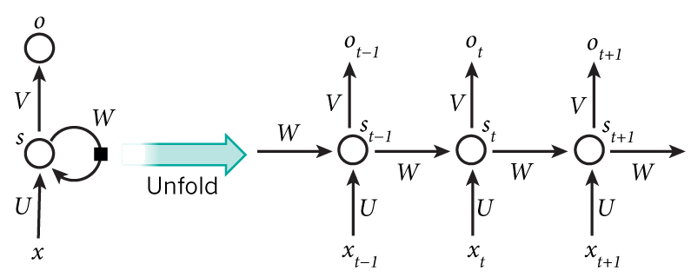
Recurrent Neural Networks (RNNs)
Hidden state at time step t
Output state at time step t
Activation function
h
h_{t-1}
h_{t}
h_{t+1}
Input at time step $t−1$
Parameters (recurrently used)

Slide 43
Recurrent Neural Networks (RNNs)
Mathematically, the computation at each time step:

Slide 44
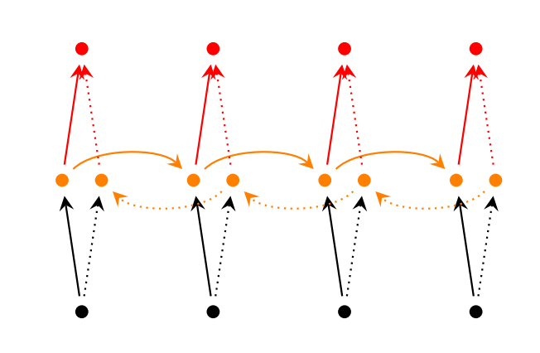
RNNs Extensions
Bidirectional RNNs
Notes:
Brain storm, why?

Slide 45
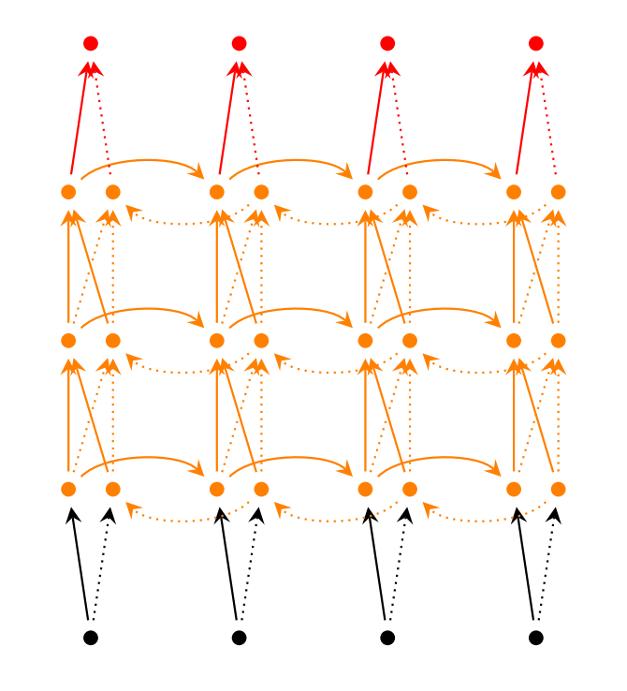
RNNs Extensions
Deep (Bidirectional) RNNs
Notes:
Brain storm, why?

Slide 46
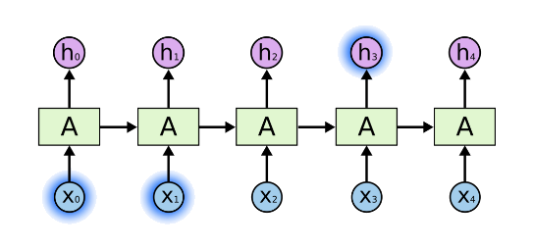
Long-Term Dependencies
Is RNN capable of capturing long-term dependencies?
Why long-term dependencies?
Sometimes we only need to look at recent information to perform present task
Consider an example
Predict next word based on the previous words
The clouds are in the sky

Slide 47
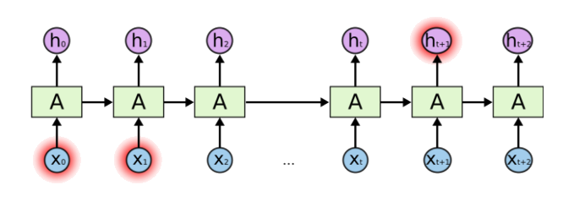
Problem of Long-Term Dependencies
What if we want to predict the next word in a long sentence?
Do we know which past information is helpful to predict the next word?
In theory, RNNs are capable of handling long-term dependencies.
But in practice, they are not!
Notes:
Vanishing gradient

Slide 48
Long Short Term Memory (LSTM)
A special type of recurrent neural networks.
Explicitly designed to capture the long-term dependency .
So, what is the structural difference between RNN and LSTM?

Slide 49
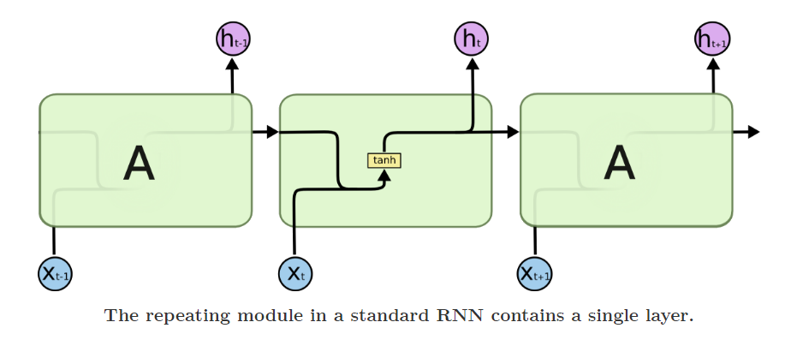
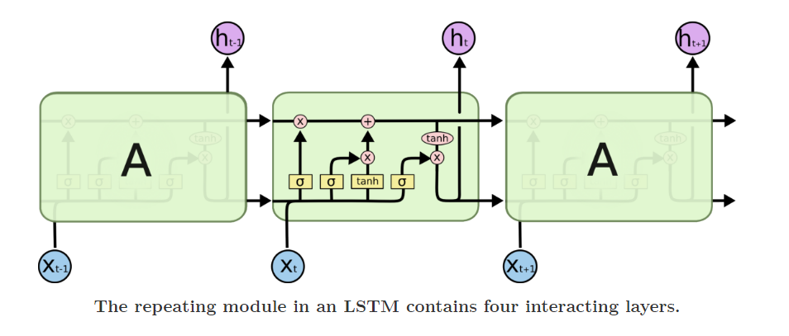
Difference between RNN and LSTM

Slide 50
I just like to stare at the equations (you may prefer the diagram)
Wx + Uh could also be written W[x;h]
Sigma_g = sigmoid, others are tanh

Slide 51
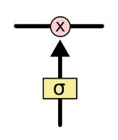
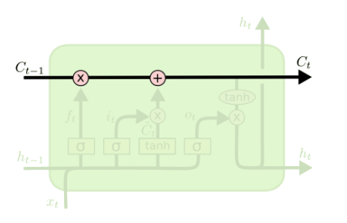
Core Idea Behind LSTM
Key to LSTMs is the memory cell state
LSTMs memory cells add and remove information as the sequence goes
How? Through a structure called gate.
LSTM has three gates to control the memory in the cells
Pointwise multiplication operation
Sigmoid neural net layer

Slide 52
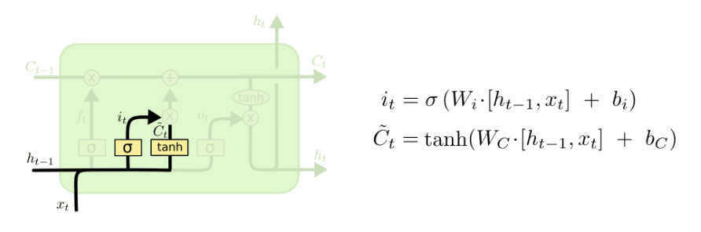

Step-by-Step LSTM Walk Through
The input gate decides what information will be stored in the cell state
Two parts –
A sigmoid layer (input gate layer): decides what values we’ll update
A $tanh⁡$layer: creates a vector of new candidate values, $\tilde{C_{t}}$
Example: add the gender of the new subject to the cell state
Replace the old one we’re forgetting
Input gate layer
tanh layer

Slide 53
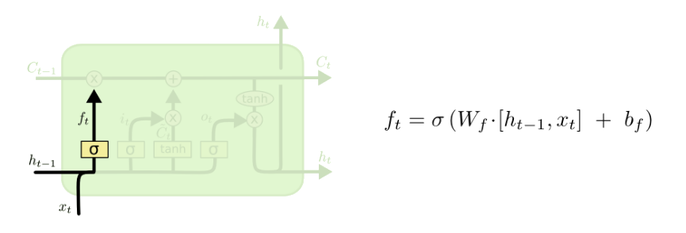

Step-by-Step LSTM Walk Through
The forget gate decides what information will be thrown away
Looks at $h_{t−1}$ and $x_{t}$ and outputs a number between 0 and 1
1 represents completely keep this, 0 represents completely get rid of this
Example: forget the gender of the old subject, when we see a new subject

Slide 54
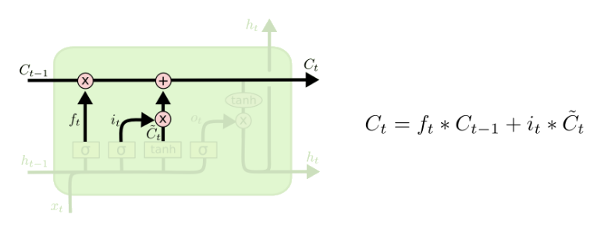
Step-by-Step LSTM Walk Through
Next step: update old state by $C_{t−1}$ into the new cell state $C_{t}$
Multiply old state by $f_{t}$
Forgetting the things we decided to forget earlier
Then we add $i_{t}∗\tilde{C_{t}}$

Slide 55
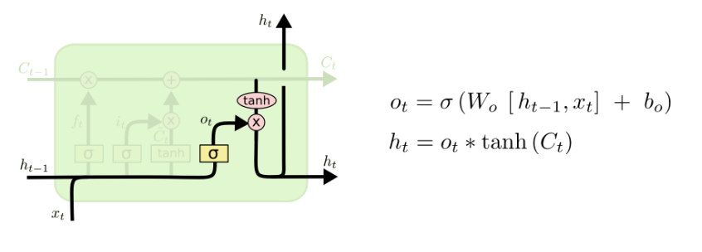
Step-by-Step LSTM Walk Through
Final step: decide what we’re going to output
First, we run a sigmoid layer
Which decides what parts of the cell state we’re going to output
Then, we put the cell state through tanh and multiply it by the output of the sigmoid gate

Slide 56
LSTMs Summary
LSTMs is an (advanced) variation of RNNs.
It captures long-term dependencies of the inputs.
Shown to be efficient in many NLP tasks.
A standard component to encode text inputs.

Slide 57
Neural MT with Attention

Slide 58
Extension: encoder often a bidirectional RNN (two RNNs working in opposite directions)

Slide 59
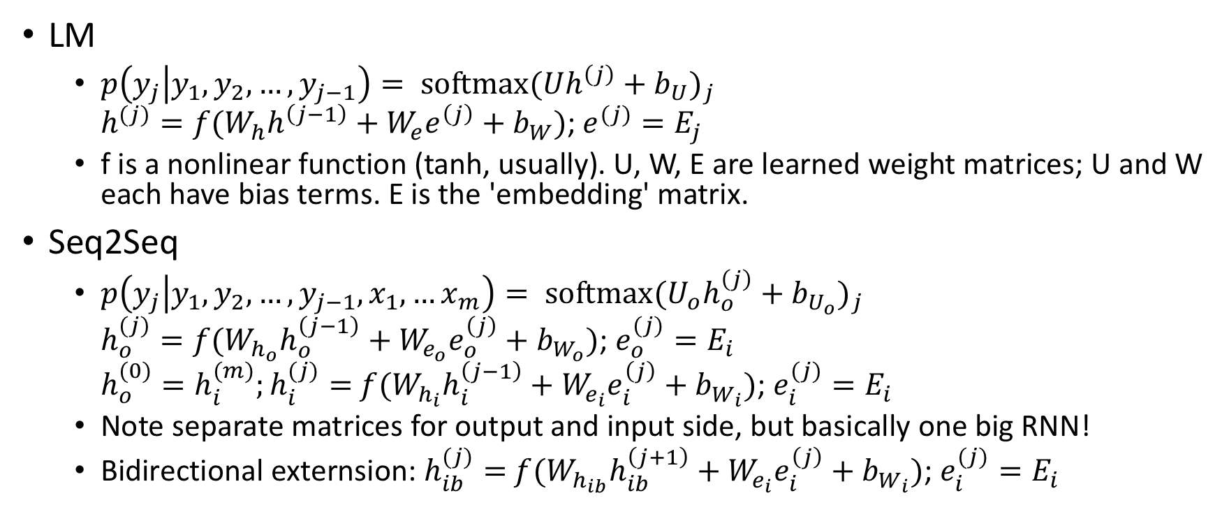
RNN LM vs Seq2Seq, mathematically
LM
$p\left(y_{j} | y_{1},y_{2},…, y_{j−1}\right)= {\text{softmax}(Uh^{\left(j\right)}+b_{U})}_{j}$ $h^{(j)}=f(W_{h}h^{\left(j−1\right)}+W_{e}e^{\left(j\right)}+b_{W})$; $e^{(j)}=E_{j}$
f is a nonlinear function (tanh, usually). U, W, E are learned weight matrices; U and W each have bias terms. E is the 'embedding' matrix.
Seq2Seq
$p\left(y_{j} | y_{1},y_{2},…, y_{j−1},x_{1},…x_{m}\right)= {\text{softmax}(U_{o}h_{o}^{\left(j\right)}+b_{U_{o}})}_{j}$ $h_{o}^{(j)}=f(W_{h_{o}}h_{o}^{\left(j−1\right)}+W_{e_{o}}e_{o}^{\left(j\right)}+b_{W_{o}})$; $e_{o}^{(j)}=E_{i}$ $h_{o}^{(0)}=h_{i}^{(m)};h_{i}^{(j)}=$ $f(W_{h_{i}}h_{i}^{\left(j−1\right)}+W_{e_{i}}e_{i}^{\left(j\right)}+b_{W_{i}})$; $e_{i}^{(j)}=E_{i}$
Note separate matrices for output and input side, but basically one big RNN!
Bidirectional externsion: $h_{ib}^{(j)}=$ $f(W_{h_{ib}}h_{ib}^{\left(j+1\right)}+W_{e_{i}}e_{i}^{\left(j\right)}+b_{W_{i}})$; $e_{i}^{(j)}=E_{i}$

Slide 74
Note: in practice there are lots of places attention can go in the networks

Slide 75
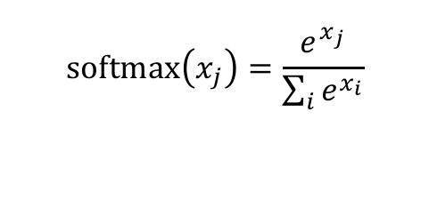
$$\text{softmax}\left(x_{j}\right)=\frac{e^{x_{j}}}{\sum_{i}{e^{x_{i}}}}$$

